Slide 1
Movie Descriptor:Film Accessibility for the Visually Impaired
Group A12: The Story-Tellers
Project Advisor: Bhavik Gandhi
Project Co-ordinator: Stanley Chor

Slide 2


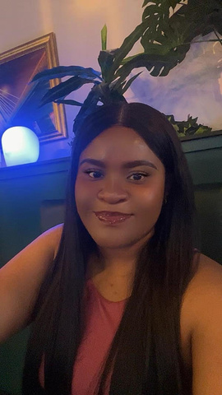





OUR TEAM MEMBERS
Prabhaharan Sankareswaran
Doris Kadiri
Project Manager
ML Engineer
Jaivin Jacob
Bhanwar Preet Singh
Tech Lead
AI Researcher
Kuldip Hareshbhai Mangrola
Neha Mehmi
Data Analyst
UI Developer
Abhishek Singh
AI Engineer

Slide 3
Agenda
Research and Surveys
1
Current Situation and Problem
2
7
How it works?
3
4
Why us?
How we are doing?
5
Summary
6

Slide 4
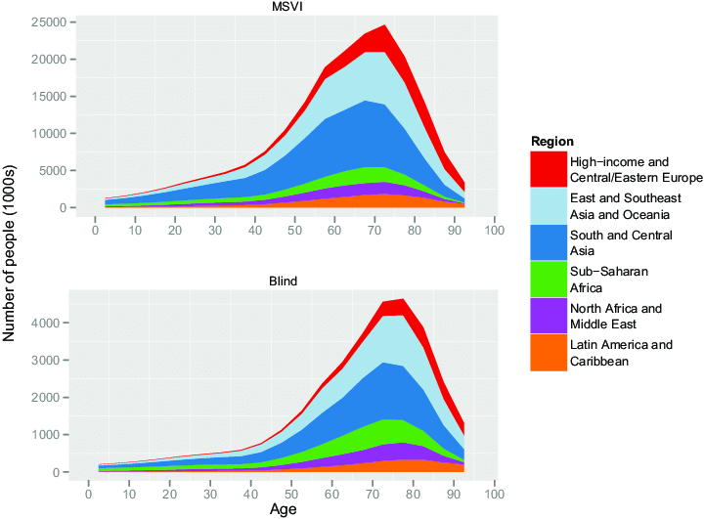
Research and Surveys
A study by the American Foundation for the Blind (AFB) found that detailed audio descriptions significantly enhance the movie-watching experience for visually impaired individuals.
According to a survey conducted by the Royal National Institute of Blind People (RNIB), 85% of visually impaired respondents reported a preference for movies with comprehensive audio descriptions over those with basic descriptions.
.

Slide 5



Current situation & problems statement
Current situation
01
02
03
According to the World Health Organization, approximately 2.2 billion people globally have vision impairment or blindness.
Existing audio descriptions often lack detail, failing to convey the full cinematic experience.
Accessibility Gap
Inadequate Quality
Revenue Potential Underutilized
Unable to fully engage with movies due to a lack of details.
Failing to convey the full range of visual information, emotions, and nuances present in movies.
Industry is missing out on a significant audience segment due to inadequate accessibility solutions.
Problems

Slide 6

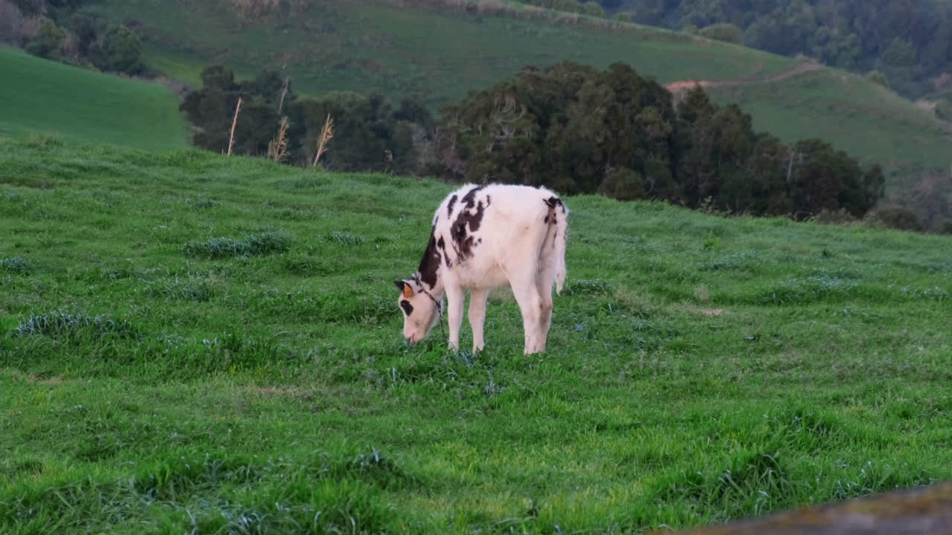
How it works
Before
After
Video with no audio description
Video with audio description
a cow standing in a grassy field

Slide 7
Why us?
Differentiation Aspect | Other Solutions | Our Product
Audio Integration | Often manual and less precise placement, potentially intrusive. | Intelligent silence detection to place descriptions without overlapping sound effects.
Scalability | Limited scalability, often focused on specific content types. | Efficiently scalable across various content types.
Technology Integration | Little use of advanced ML and NLP techniques. | Leverages pretrained machine learning models and NLP for accurate text descriptions.
Detail and Immersion | Bounded user feedback integration. | Continuous feedback from visually impaired users for better experience.

Slide 8
How we are doing?
1
VIDEO DATASET
4
3
2
TEXT GENERATION
TRANSFER LEARNING
PRETRAINED MODEL
5
6
7
TEXT TO SPEECH
SILENECE DETECTION
NARRATION PLACEMENT
10
9
8
REFINEMENT AND IMPROVE
FINAL VIDEO WITH AUDIO DESCRIPTION
TESTING AND FEEDBACK

Slide 9
Summary
Impact: Our project significantly enhances the movie-watching experience by providing comprehensive and immersive audio descriptions.
Value Proposition: Our solution stands out due to its detailed descriptions, advanced technology integration, innovative audio placement, and scalability
Benefits: Opens new revenue streams and enhances brand reputation by promoting inclusivity.
Future Outlook: Continuous improvement through user feedback and technological advancements will keep our solution at the forefront of accessibility in the film industry.

